Slide 1
Core spring
Module 14

Slide 2
Content
Spring overview
Spring main features & Spring architecture
IoC & Dependency Injection
Core Container, Web layer and Application Context
My First Spring project

Slide 3
Spring overview
Software application framework on the top of java
Ready to use software for budling enterprise applications
Opensource software
Enables budling applications using POJO’s and java classes avoiding the complexity of too much extra configurations

Slide 4
Spring main features & Spring architecture
Spring
Usage of POJO’s
Flexible in configurations
Modules bases
Aspects
Testable
Inversion of Control
Transparency
Features

Slide 5
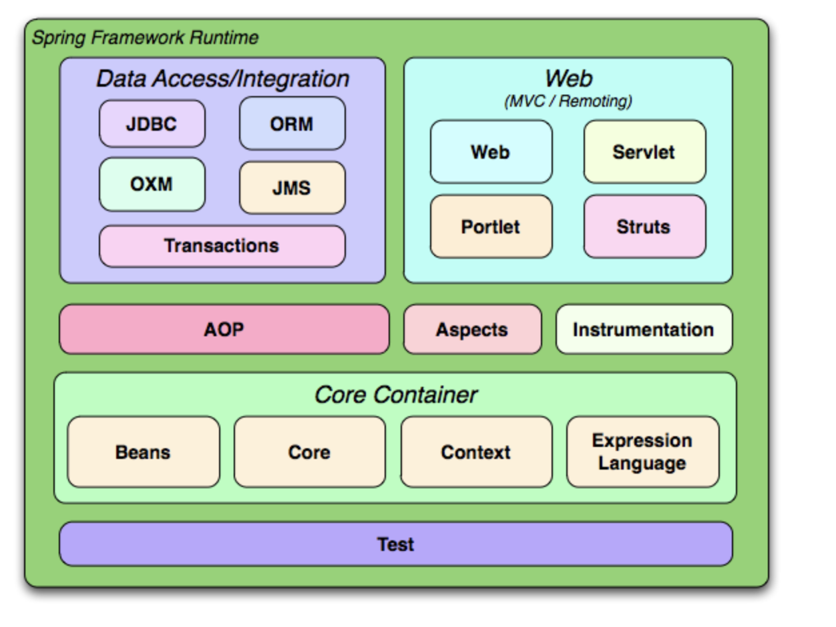
Spring main features & Spring architecture
Architecture
Source: https://docs.spring.io/spring-framework/docs/3.0.x/spring-framework-reference/html/overview.html

Slide 6
IoC & Dependency Injection
Inversion of Control
Principle where the control flow of the program in inverted
E.g. a library or a framework (like Spring IoC container) takes care about to pass implementations to the classes using them
Create instances of dependencies first and later instance of the class using these dependencies
Inversion of the way of how the instances of dependencies are being injected into the class using them
Dependency Injection
Concrete implementation (pattern) of IoC
Injecting objects (dependencies) into the classes required them via constructors or setters

Slide 7
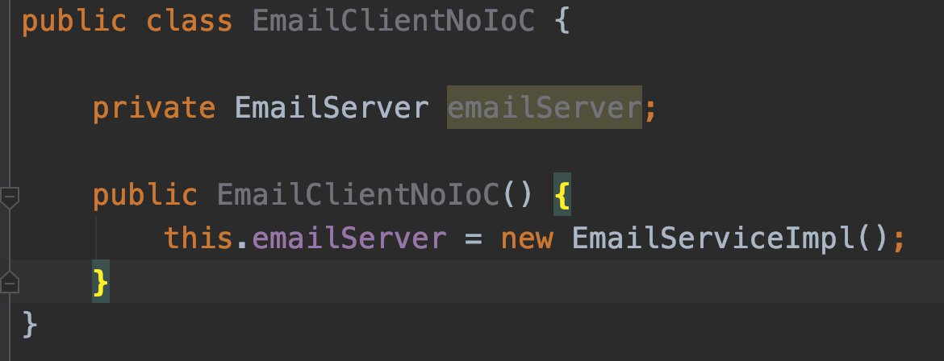
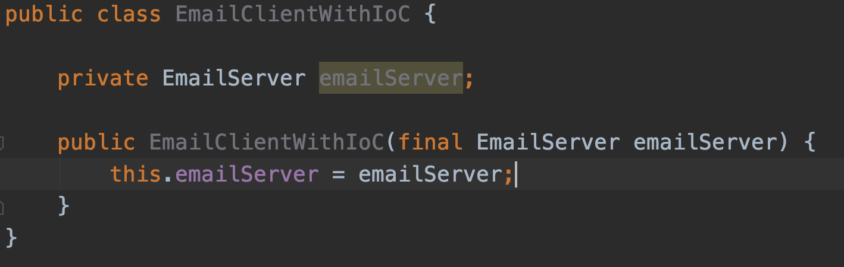
IoC & Dependency Injection
No IoC
Yes IoC

Slide 8
Core Container, Web layer and Application Context
IoC core container
The core in spring framework
Core functions
Creates instances
injecting (wired) them into the depended instances
manage their lifecycle
Types of containers
BeanFactory – provides the core of DI and support for beans (instances) lifecycle management
ApplicationContext – extended version of BeanFactory, allows enterprise beans management

Slide 9
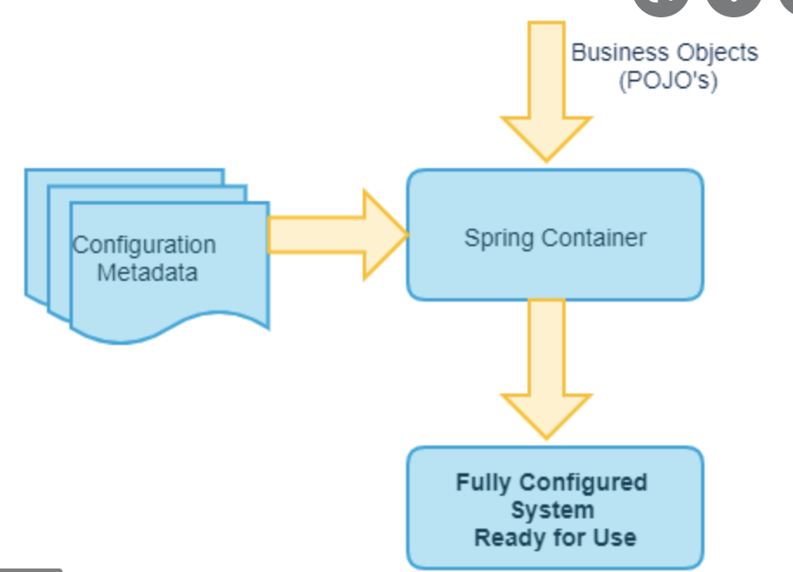
Core Container, Web layer and Application Context

Slide 10
Core Container, Web layer and Application Context
org.springframework.context.ApplicationContext
Is an interface represents the IoC Container
Instantiates, configure and wired the instances (beans) insight the container
Configured via XML files or Java annotations

Slide 11
My First Spring project
Demo

Slide 12
Questions?
Notes:
Do you have any questions?

Slide 13
Thank You For Your Time

